Slide 2
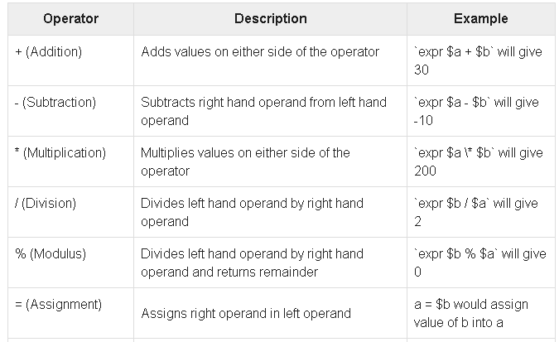
Arithmetic
Assume variable a holds 10 and variable b holds 20 then

Slide 3
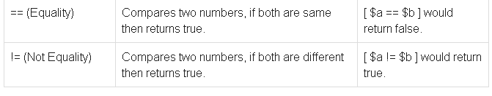
It is very important to understand that all the conditional expressions should be inside square braces with spaces around them, for example [ $a == $b ] is correct whereas, [$a==$b] is incorrect.
All the arithmetical calculations are done using long integers.

Slide 4
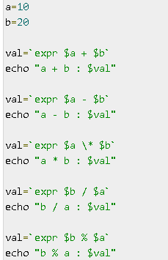

Slide 5
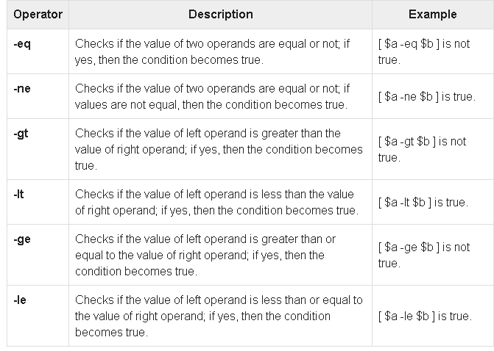
Relational Operators
Assume variable a holds 10 and variable b holds 20 then

Slide 6
It is very important to understand that all the conditional expressions should be placed inside square braces with spaces around them

Slide 7
Using the Bash Arithmetic Expansion
to evaluate arithmetic expressions with integers in Bash is to use the Arithmetic Expansion capability of the shell. The builtin shell expansion allows you to use the parentheses ((...)) to do math calculations.
The format for the Bash arithmetic expansion is $(( arithmetic expression )). The shell expansion will return the result of the latest expression given.

Slide 8
Control Structures
if [ expression ] then command1 else command2 fi

Slide 9
if [ expression ] then command1 elif [ expression ] then
command2
elif [ expression ] then
command3
else
command4 fi

Slide 10
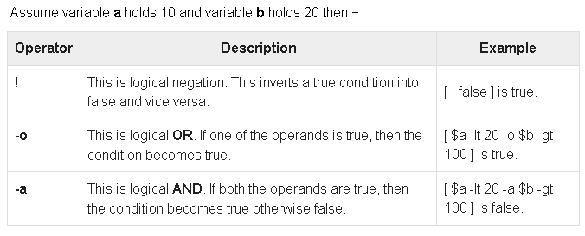
Logical Operator

Slide 11
while [ expression ]
do
Statement(s) to be executed if expression is true
done
i=0
while [ $i –le 5 ]
do
echo “$i”
i=`expr$i + 1`
done
i=0
While(($i < 5 ))
do
echo “$i”
i=`expr$i + 1`
done

Slide 12
Nesting Loops
All the loops support nesting concept which means you can put one loop inside another similar one or different loops. This nesting can go up to unlimited number of times based on your requirement.
Here is an example of nesting while loop. The other loops can be nested based on the programming requirement in a similar way −

Slide 13
Nesting while Loops It is possible to use a while loop as part of the body of another while loop
.Syntax
while command1 ; # this is loop1, the outer loop
do
Statement(s) to be executed if command1 is true
while command2 ; # this is loop2, the inner loop
do
Statement(s) to be executed if command2 is true
done
Statement(s) to be executed if command1 is true
done

